Slide 1
Recipe Hub - Demo
TIAN Dippenaar and Devon Collins

Slide 2
Overview
Problem
Aim
Scope
Objectives
Traditional Recipe Books are slow to navigate through.
Accumulate too many Recipe Books overtime.
Tedious Process to share a recipe traditionally.
To reduce the time, it takes to search for a specific recipe by developing a collaborative Recipe Book with an ambitious search engine.
Simply Put:
To create a mobile application for the storage and sharing of recipes
Research existing applications, investigate them and find areas for improvement.
Create and Design a model for the application.
Create a basic usable prototype.
Analyse our prototype and document our findings.

Slide 3
MOV Statement
“In order for this IT Project to be deemed successful, a recipe must be able to be viewed within 15 seconds of opening the application.”

Slide 4
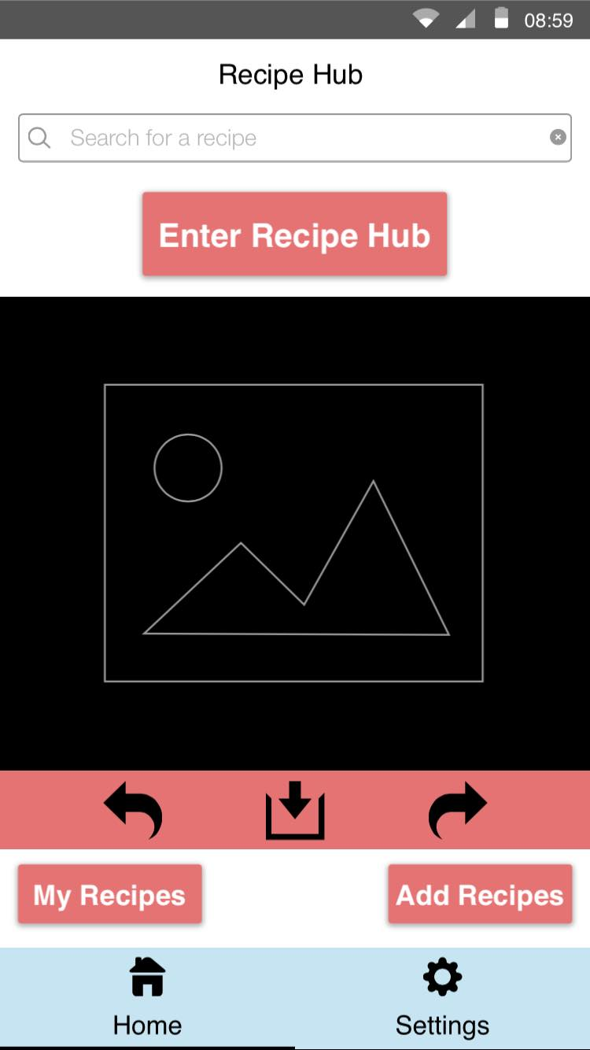
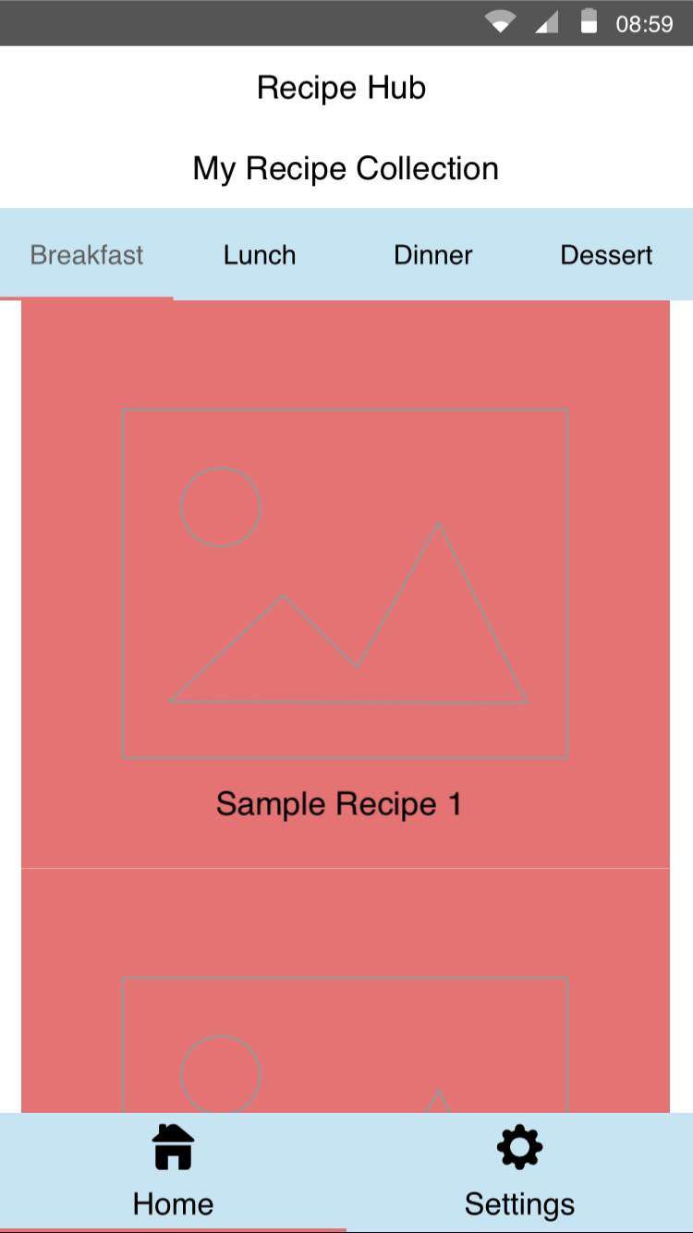
GUI Initial Design

Slide 5
Error Handling / Limitations
Learning Android Development for the first time.
Android Developers
YouTube
Stack Overflow
Used the Log.d Function to Log Methods for Debugging.
If errors occurred I can find exactly where they occurred.
Learning to use components such as RecyclerViews.
SQL Query inputted wrong.
Time Constraints.

Slide 6
Functionalities
Achieved
Adding a Recipe
Validation
Viewing Recipe List
Viewing Individual Recipes
Searching for Recipes
Store Recipes via Room Persistence Library
Not Achieved
Implement Online Database
Upload Recipe to Online Database Function
Camera/Gallery Access for Recipe Photos
Update/ Delete Recipes

Slide 7
Future Work
All the ‘Not Achieved’
Share to Social Media
Login System
Rating System
Available on IOS

Slide 8
Demonstration

